Slide 1
BUSINESS SET-UP LOCATION RECOMMENDATION
Thanya Ramanathan

Slide 2
BUSINESS PROBLEM
Tourism facilitates large number of employment opportunities. This project analyses the most popular places in a state in India to recommend the best choice for setting up restaurants, hotels, souvenir shops or other businesses that tourism may help flourish. This project will also be helpful for freelancers like translators, artists, etc., to set up stalls.

Slide 3
DATA ACQUISITION AND CLEANING
List of states and their respective districts from https://en.wikipedia.org/wiki/List_of_districts_in_India .
Geopy API was used to obtain the latitudes and longitudes of all the districts
The raw dataset contains 794 rows and 8 columns
Duplicate values, none values and irrelevant columns were dropped
The cleaned dataset contains 727 rows and 5 columns

Slide 4
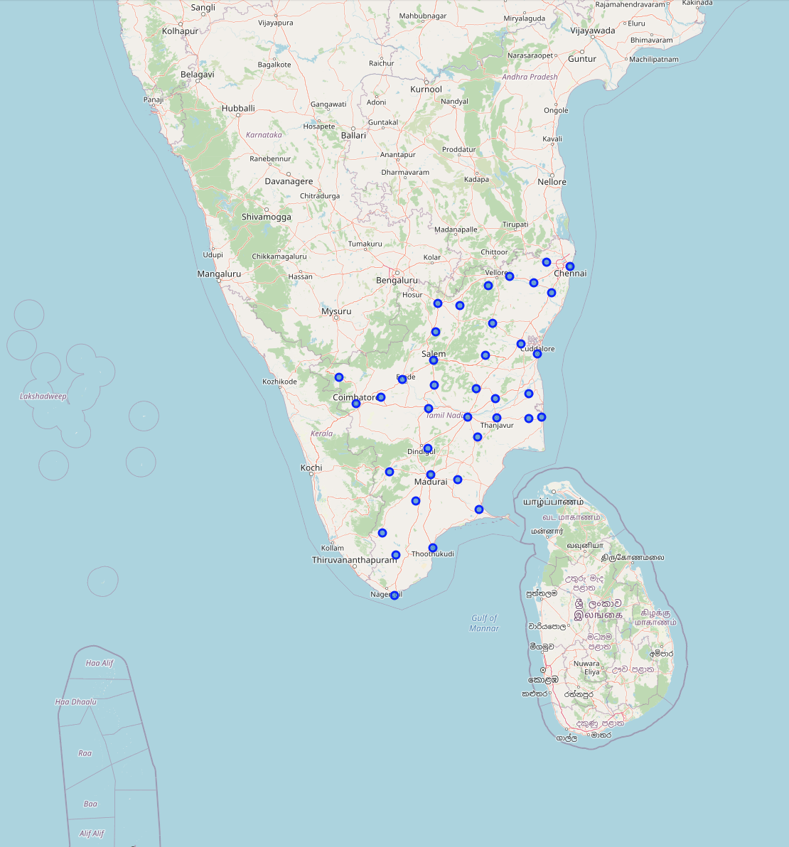
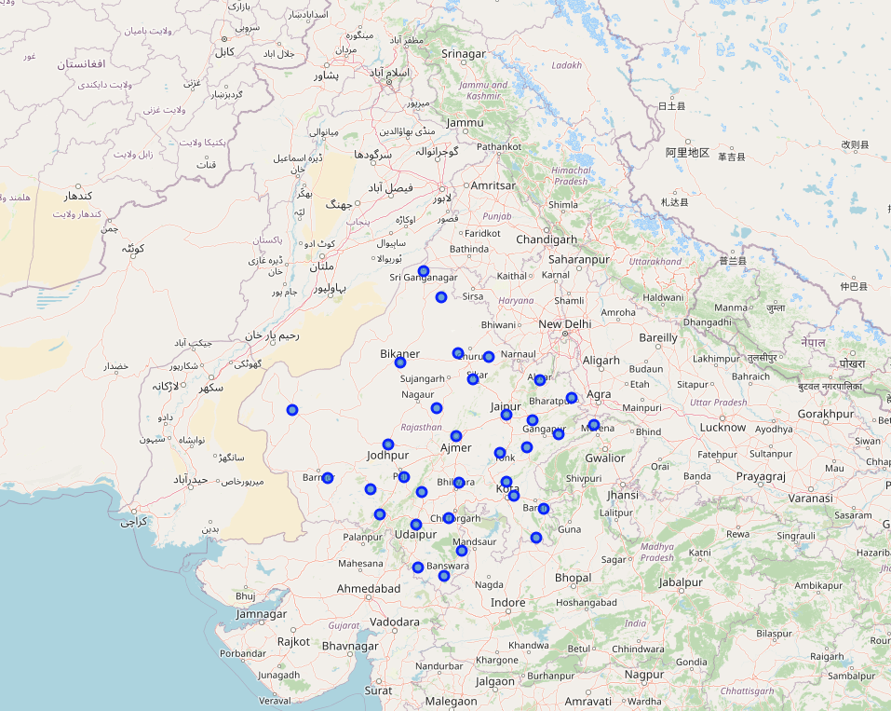
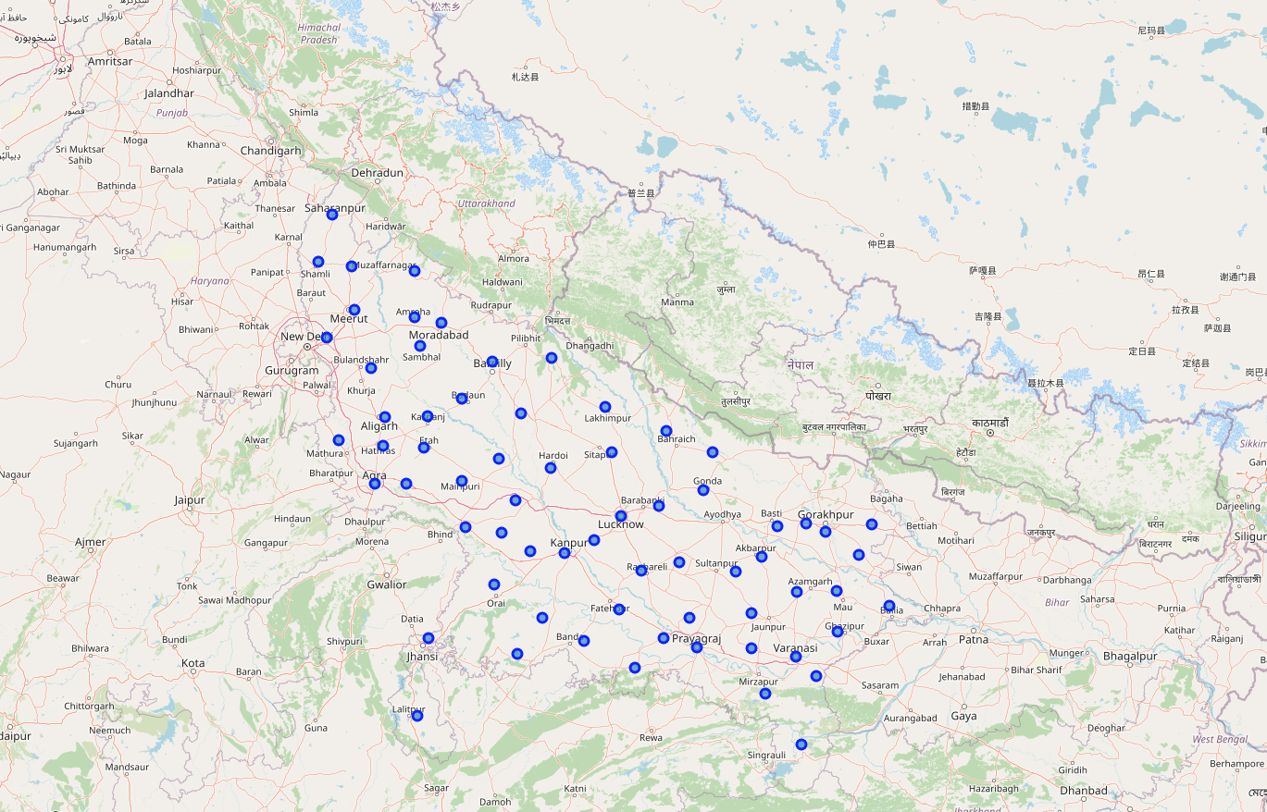
DISTRICTS IN THE CHOSEN STATE
Rajasthan
Tamil Nadu
Uttar Pradesh

Slide 5
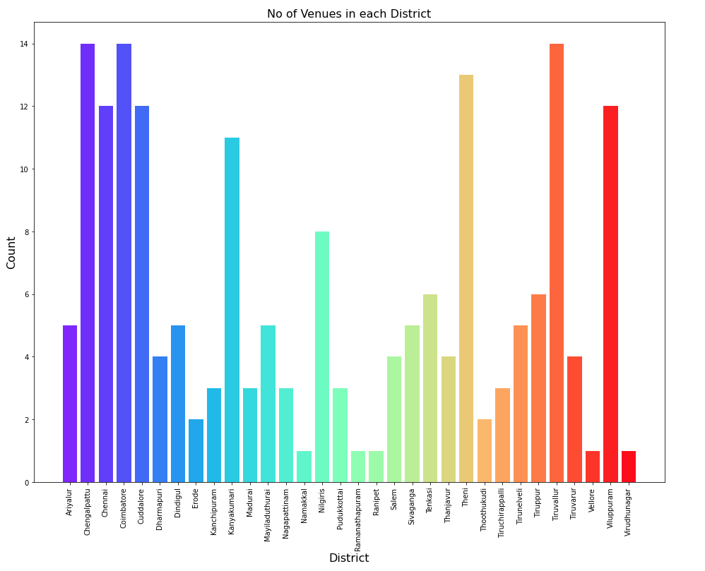
NUMBER OF VENUES OBTAINED IN EACH DISTRICT
Tamil Nadu
UTTAR PRADESH

Slide 6
PROJECT FLOW
Data frame creation
Visualisation of the districts
Get nearby venues in each district
Analyse each district
Sort the most common venues
Get nearby businesses
Analyse all business categories
K-Means clustering, cluster maps
Cluster Examination

Slide 7
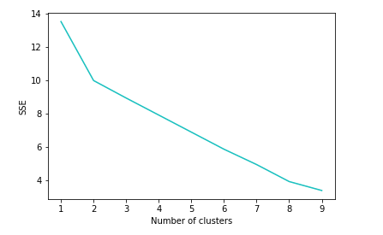
OBTAINING OPTIMAL K VALUE

Slide 8
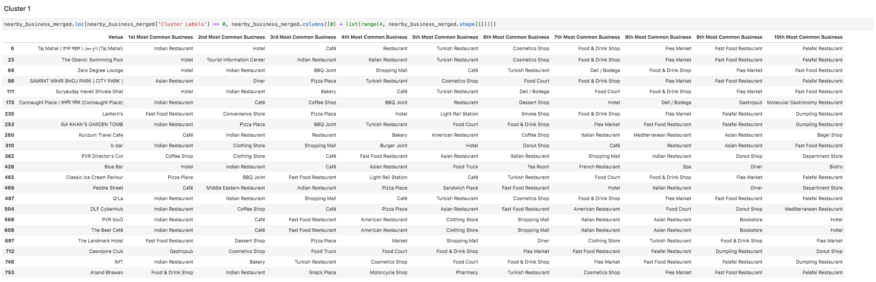
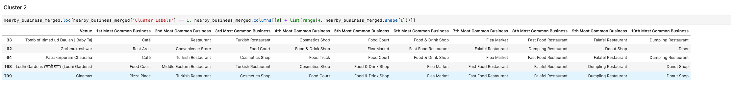
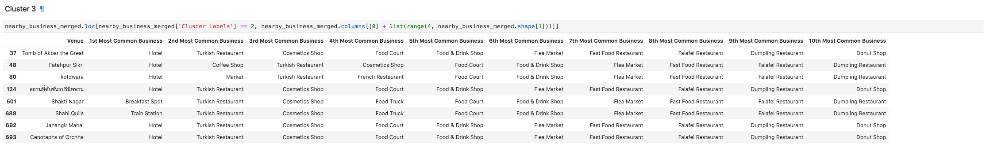
CLUSTERS
Uttar Pradesh

Slide 9
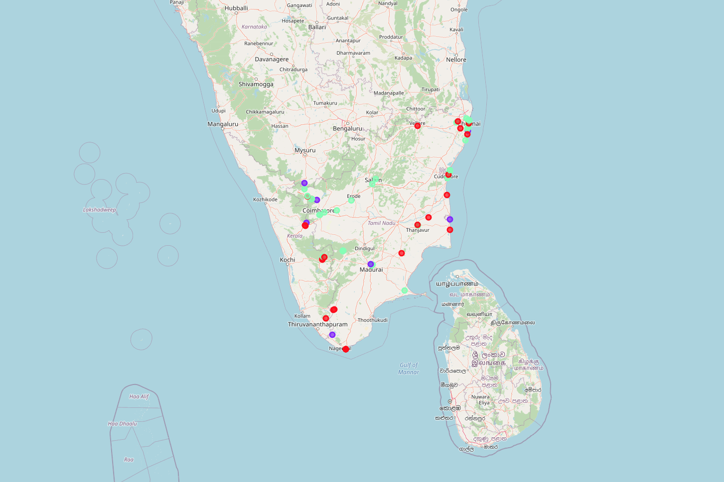
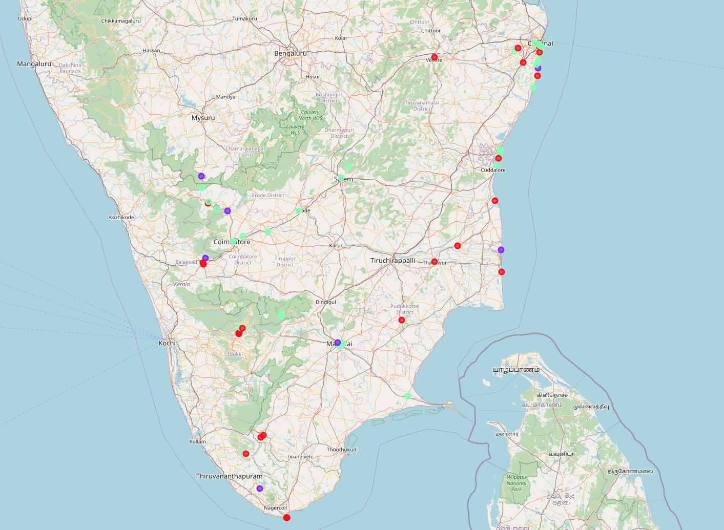
CLUSTER MAP
The purple, green and red markers represent clusters 1, 2 and 3 respectively.
The region close to Chennai has the most number of business outlets.
Most of these venues have restaurants, cafés and food shops. Other types of establishments can be found as well.

Slide 10
CONCLUSION
K-Means clustering algorithm has been used to segregate tourist spots into clusters.
It shows the most preferred areas to set up business.
The project can be developed to include accessibility and business rates to give a more accurate analysis to the user.

